Slide 1
Chapter 7
Introduction to Cassandra

Slide 2
Learning Objectives and Learning Outcomes
Learning Objectives | Learning Outcomes
Introduction to Cassandra To study the features of Cassandra. To learn how to perform CRUD operations. To learn about collections in Cassandra. To import from and export to CSV format. | To comprehend the reasons behind the popularity of NoSQL database. To be able to perform CRUD operations. To distinguish between collections types such as SET, LIST and MAP. To be able to successfully import from CSV. To be able to successfully export to CSV.

Slide 3
Session Plan
Lecture time 45 to 60 minutes
Q/A 15 minutes

Slide 4
Agenda
Apache Cassandra – An Introduction
Features of Cassandra
  Peer-to-Peer Network
  Writes in Cassandra
  Hinted Handoffs
  Tunable Consistency: Read Consistency and Write Consistency
CQL Data Types
CQLSH
CRUD : Insert, Update, Delete and Select
Collections : Set, List and Map
Time To Live (TTL)
Import and Export

Slide 5
Apache Cassandra – An Introduction
Notes:
NoSQL stands for Not Only SQL.

Slide 6
Apache Cassandra – An Introduction
Apache Cassandra was born at Facebook. After Facebook open sourced the code in 2008, Cassandra became an Apache Incubator project in 2009 and subsequently became a top-level Apache project in 2010.
It is a column-oriented database designed to support peer-to-peer symmetric nodes instead of the master−slave architecture.
It is built on Amazon’s dynamo and Google’s BigTable.

Slide 7
Features of Cassandra

Slide 8
Features of Cassandra
Open Source
Distributed
Decentralized (Server Symmetry)
No single point of failure
Column-oriented
Peer to Peer
Elastic Scalability

Slide 9
Peer to Peer Network

Slide 10
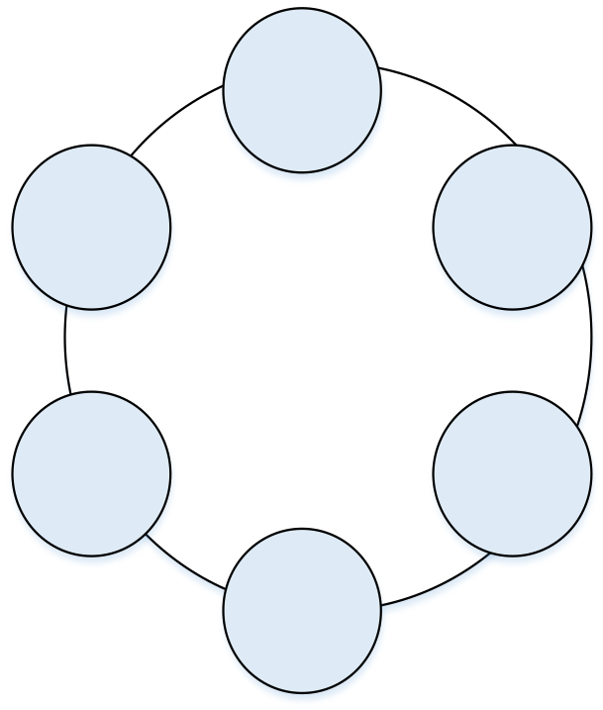
Sample Cassandra Cluster
Notes:
NoSQL are non-relational databases.

Slide 11
Writes in Cassandra

Slide 12
Writes in Cassandra
A client that initiates a write request.
It is first written to the commit log. A write is taken as successful only if it is written to the commit log.
The next step is to push the write to a memory resident data structure called Memtable. A threshold value is defined in the Memtable.
When the number of objects stored in the Memtable reaches a threshold, the contents of Memtable are flushed to the disk in a file called SSTable (Stored string Table). Flushing is a non-blocking operation.
It is possible to have multiple Memtables for a single column family. One out of them is current and the rest are waiting to be flushed.

Slide 13
Hinted Handoffs

Slide 14
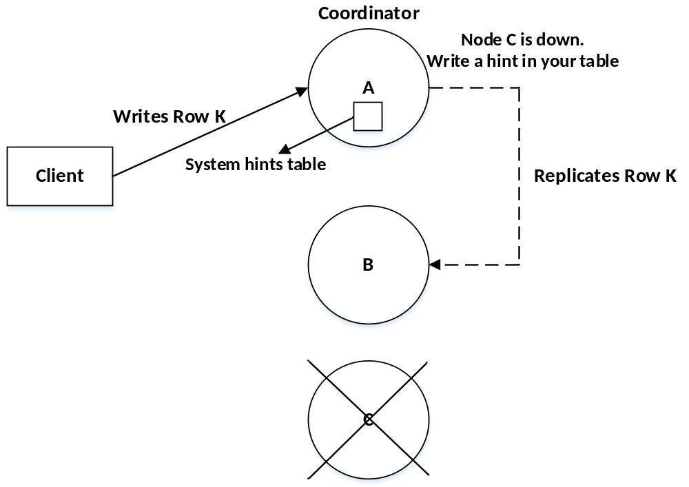
Hinted Handoffs

Slide 15
Tunable Consistency

Slide 16
Read Consistency
ONE | Returns a response from the closest node (replica) holding the data.
QUORUM | Returns a result from a quorum of servers with the most recent timestamp for the data.
LOCAL_QUORUM | Returns a result from a quorum of servers with the most recent timestamp for the data in the same data center as the coordinator node.
EACH_QUORUM | Returns a result from a quorum of servers with the most recent timestamp in all data centers.
ALL | This provides the highest level of consistency of all levels and the lowest level of availability of all levels. It responds to a read request from a client after all the replica nodes have responded.

Slide 17
Write Consistency
ALL | This is the highest level of consistency of all levels as it necessitates that a write must be written to the commit log and Memtable on all replica nodes in the cluster.
EACH_QUORUM | A write must be written to the commit log and Memtable on a quorum of replica nodes in all data centers.
QUORUM | A write must be written to the commit log and Memtable on a quorum of replica nodes.
LOCAL_QUORUM | A write must be written to the commit log and Memtable on a quorum of replica nodes in the same data center as the coordinator node. This is to avoid latency of inter-data center communication.
ONE | A write must be written to the commit log and Memtable of at least one replica node.
TWO | A write must be written to the commit log and Memtable of at least two replica nodes.
THREE | A write must be written to the commit log and Memtable of at least three replica nodes.
LOCAL_ONE | A write must be sent to, and successfully acknowledged by, at least one replica node in the local data center.

Slide 18
CQL Data types

Slide 19
CQL Data types
Int | 32 bit signed integer
Bigint | 64 bit signed long
Double | 64-bit IEEE-754 floating point
Float | 32-bit IEEE-754 floating point
Boolean | True or false
Blob | Arbitrary bytes, expressed in hexadecimal
Counter | Distributed counter value
Decimal | Variable – precision integer
List | A collection of one or more ordered elements
Map | A JSON style array of elements
Set | A collection of one or more elements
Timestamp | Date plus time
Varchar | UTF 8 encoded string
Varint | Arbitrary-precision integers
Text | UTF 8 encoded string

Slide 20
CQLSH

Slide 21
CRUD - Keyspace
To create a keyspace by the name “Students”
CREATE KEYSPACE Students WITH REPLICATION = {
'class':'SimpleStrategy',
'replication_factor':1
};

Slide 22
CRUD – Create Table
To create a column family or table by the name “student_info”.
CREATE TABLE Student_Info (
RollNo int PRIMARY KEY,
StudName text,
DateofJoining timestamp,
LastExamPercent double
);

Slide 23
CRUD - Insert
To insert data into the column family “student_info”.
BEGIN BATCH
INSERT INTO student_info (RollNo,StudName,DateofJoining,LastExamPercent)
VALUES (1,'Michael Storm','2012-03-29', 69.6)
INSERT INTO student_info (RollNo,StudName,DateofJoining,LastExamPercent)
VALUES (2,'Stephen Fox','2013-02-27', 72.5)
APPLY BATCH;

Slide 24
CRUD - Select
To view the data from the table “student_info”.
SELECT *
FROM student_info;

Slide 25
CRUD – Create Index
To create an index on the “studname” column of the “student_info” column family use the following statement
CREATE INDEX ON student_info(studname);

Slide 26
CRUD – Update
To update the value held in the “StudName” column of the “student_info” column family to “David Sheen” for the record where the RollNo column has value = 2.
Note: An update updates one or more column values for a given row to the Cassandra table. It does not return anything.
UPDATE student_info SET StudName = 'David Sheen' WHERE RollNo = 2;

Slide 27
CRUD – Delete
To delete the column “LastExamPercent” from the “student_info” table for the record where the RollNo = 2.
Note: Delete statement removes one or more columns from one or more rows of a Cassandra table or removes entire rows if no columns are specified.
DELETE LastExamPercent FROM student_info WHERE RollNo=2;

Slide 28
Collections

Slide 29
Collections
When to use collection?
Use collection when it is required to store or denormalize a small amount of data.
What is the limit on the values of items in a collection?
The values of items in a collection are limited to 64K.
Where to use collections?
Collections can be used when you need to store the following:
1. Phone numbers of users.
2. Email ids of users.

Slide 30
Collections - Set
To alter the schema for the table “student_info” to add a column “hobbies”.
ALTER TABLE student_info ADD hobbies set<text>;

Slide 31
Collections - Set
To update the table “student_info” to provide the values for “hobbies” for the student with Rollno =1.
UPDATE student_info
SET hobbies = hobbies + {'Chess, Table Tennis'}
      WHERE RollNo=1;

Slide 32
Collections - List
To alter the schema of the table “student_info” to add a list column “language”.
ALTER TABLE student_info ADD language list<text>;

Slide 33
Collections - List
To update values in the list column, “language” of the table “student_info”.
UPDATE student_info
SET language = language + ['Hindi, English']
WHERE RollNo=1;

Slide 34
Collections - Map
To alter the “users” table to add a map column “todo”.
ALTER TABLE users
ADD todo map<timestamp, text>;

Slide 35
Collections - Map
To update the record for user (user_id = ‘AB’) in the “users” table.
UPDATE users
SET todo =
{ ‘2014-9-24’: ‘Cassandra Session’,
‘2014-10-2 12:00’ : ‘MongoDB Session’ }
WHERE user_id = ‘AB’;

Slide 36
Time To Live

Slide 37
Time To Live
Data in a column, other than a counter column, can have an optional expiration period called TTL (time to live). The client request may specify a TTL value for the data. The TTL is specified in seconds.
CREATE TABLE userlogin(
userid int primary key, password text
);
INSERT INTO userlogin (userid, password) VALUES (1,'infy') USING TTL 30;
SELECT TTL (password)
FROM userlogin
WHERE userid=1;

Slide 38
Export to CSV

Slide 39
Export data to a CSV file
Export the contents of the table/column family “elearninglists” present in the “students” database to a CSV file (d:\elearninglists.csv).
COPY elearninglists (id, course_order, course_id, courseowner, title) TO 'd:\elearninglists.csv';

Slide 40
Import from CSV

Slide 41
Import data from a CSV file
To import data from “D:\elearninglists.csv” into the table “elearninglists” present in the “students” database.
COPY elearninglists (id, course_order, course_id, courseowner, title) FROM 'd:\elearninglists.csv';

Slide 42
Answer a few quick questions …

Slide 43
Answer Me
What is Cassandra?
Comment on Cassandra writes.
What is your understanding of tunable consistency?
What are collections in CQLSH? Where are they used?

Slide 44
Summary please…
Ask a few participants of the learning program to summarize the lecture.

Slide 45
References …

Slide 46
Further Readings
http://www.datastax.com/documentation/cassandra/2.0/cassandra/gettingStartedCassandraIntro.html
http://www.datastax.com/documentation/cql/3.1/pdf/cql31.pdf
http://www.datastax.com/documentation/cassandra/2.0/cassandra/dml/dml_config_consistency_c.html

Slide 47
Thank you

